Slide 1
UNIT-II Sequential Circuits

Slide 2
Syllabus
Flip-flops: SR flip-flop, Edge-triggered flip-flops (SR,D,JK and T), Master slave JK flip-flop - 4-bit binary asynchronous and synchronous counter - Decade counter (asynchronous and synchronous) - Shift registers (SISO, SIPO, PISO, PIPO) - Ring counter – Memories (RAM, ROM, EPROM, FLASH)

Slide 3
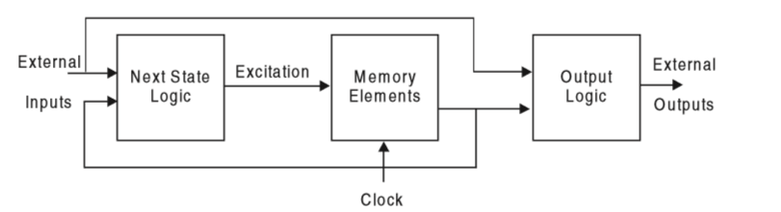
Sequential Circuit?
The logic circuits whose outputs at any instant of time depend only on the input signals present at that time are known as combinational circuits.
The output in combinational circuits does not depend upon any past inputs or outputs.

Slide 4
Sequential Vs Combinational
Combinational circuits are often faster than sequential circuits since the combinational circuits do not require memory elements whereas the sequential circuit needs memory elements to perform its operations in sequence.
Sequential circuits are broadly classiﬁed into two main categories, known as synchronous or clocked and asynchronous or un clocked sequential circuits, depending on the timing of their signals.

Slide 5
Synchronous Sequential Circuits
A sequential circuit whose behaviour can be deﬁned from the knowledge of its signal at discrete instants of time is referred to as a synchronous sequential circuit.
In these systems, the memory elements are affected only at discrete instants of time. The synchronization is achieved by a timing device known as a system clock

Slide 6
Asynchronous Sequential Circuits
A sequential circuit whose behaviour depends upon the sequence in which the input signals change is referred to as an asynchronous sequential circuit.
The output will be affected whenever the input changes. The commonly used memory elements in these circuits are time-delay devices.
There is no need to wait for a clock pulse. Therefore, in general, asynchronous circuits are faster than synchronous sequential circuits.

Slide 7
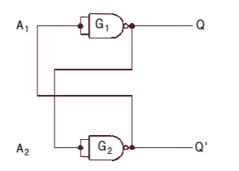
Latch
Assume the output of G1 to be Q = 0, which is also the input of G2 (A2 = 0). Therefore, the output of G2 will be Q' = 1, which makes A1 = 1 and consequently Q = 0 which is according to our assumption.
And if the circuit is in 1 state, it continues to remain in this state and vice versa is also true. Since this information is locked or latched in this circuit, therefore, this circuit is also referred to as a latch.

Slide 8
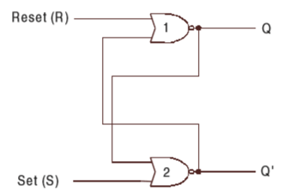
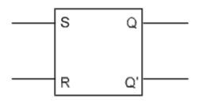
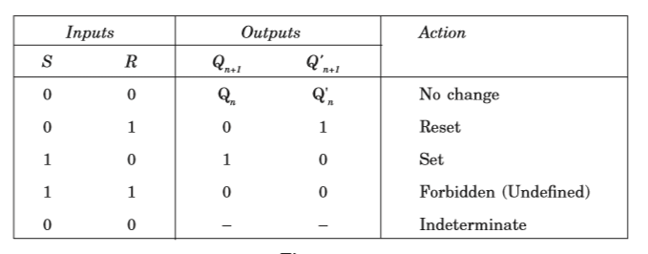
S-R (Set-Reset) Flip-flop
Ref class notes for explanation
consider the fact that the output of a NOR gate is 0 if any of the inputs are 1, irrespective of the other input.

Slide 9
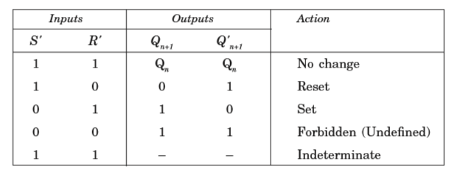
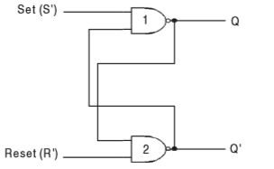
SR Flip-Flop Using NAND gates

Slide 10
Clocked SR Flip-Flop
Additional Control Signal (Clock signal) is used in Flip-Flops
Refer Class Notes

Slide 11
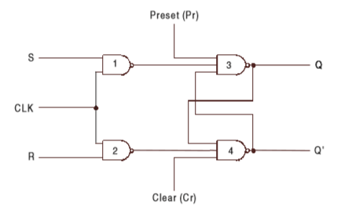
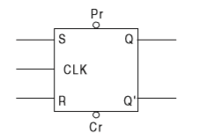
Pre set and Clear
If Pr = 1 and Cr = 0, the output of NAND gate 4 is forced to be 1, i.e., Q' = 1 and the ﬂ ip-ﬂ op is reset, overwriting the previous state of the ﬂ ip-ﬂ op.
If Pr = 0 and Cr = 1, the output of NAND gate 3 is forced to be 1, i.e., Q = 1 and the ﬂ ip-ﬂ op is set, overwriting the previous state of the ﬂ ip-ﬂ op. Once the state of the ﬂ ip-ﬂ op is established asynchronously, the inputs Pr and Cr must be connected to logic 1 before the next clock is applied.

Slide 12
D , JK ,Master/slave and T Flip-Flops
Ref Class Notes

Slide 13
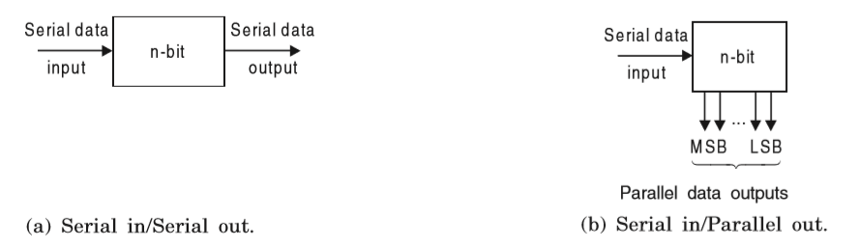
SHIFT REGISTER
A register capable of shifting its binary contents either to the left or to the right is called a shift register.

Slide 14
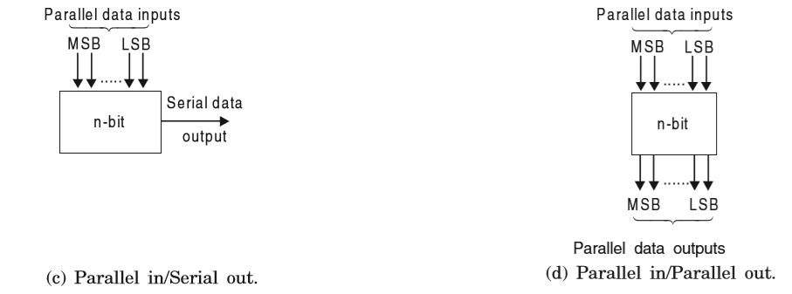

Slide 15
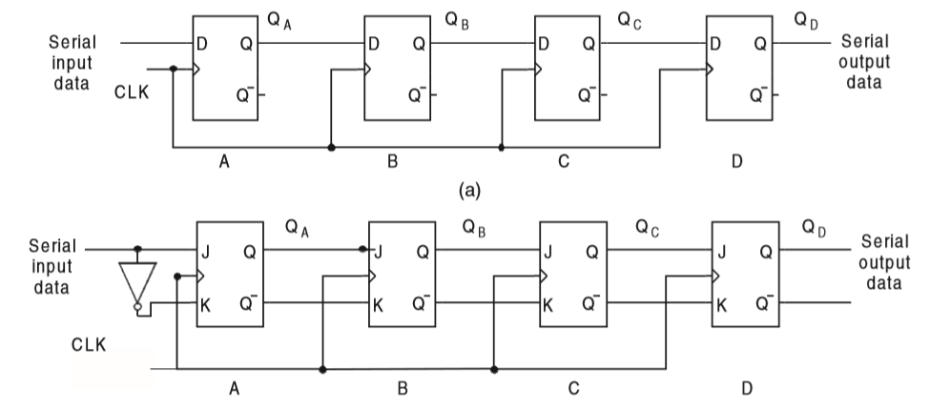
Serial In Serial Out
Shift-right Register

Slide 16
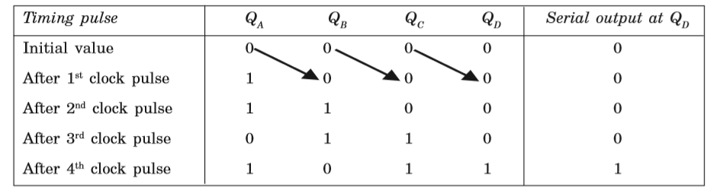
Operation if input is 1011

Slide 17
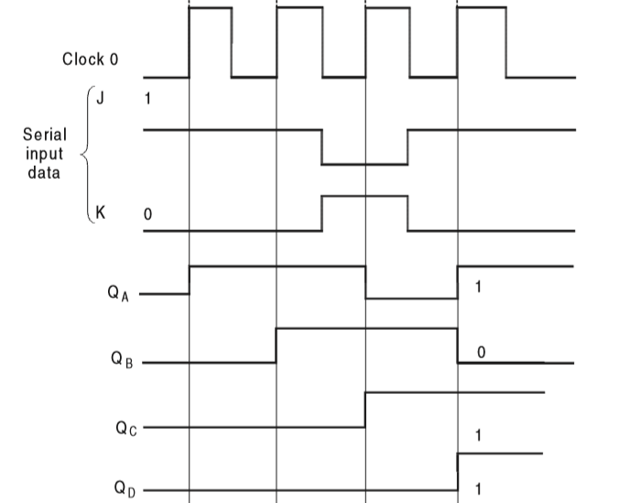

Slide 18
For a J-K ﬂip-ﬂop, the data bit to be shifted into the ﬂip-ﬂop must be present at the J and K inputs when the clock transitions from low to high occur. Since the data bit is either 1 or 0, there can be two different cases:
(i)To shift a 1 into the ﬂip-ﬂop, J = 1 and K = 0,
(ii)To shift a 0 into the ﬂip-ﬂ op, J = 0 and K = 1.

Slide 19
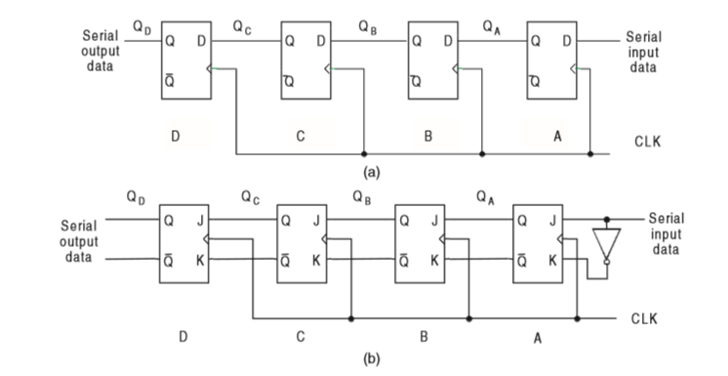
SISO
Shift Right Shift register

Slide 20
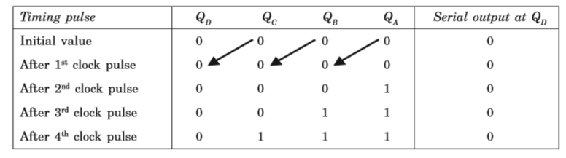

Slide 21
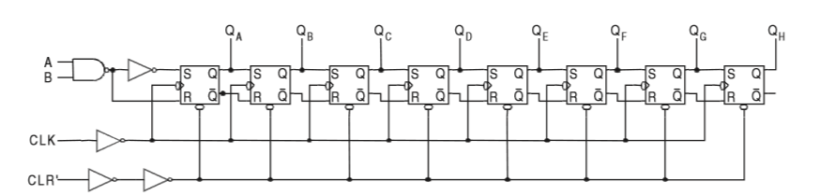
Serial In Parallel Out

Slide 22
When A is held high: The NAND gate is enabled and the serial input data passes through the NAND gate inverted. The input data is shifted serially into the register.
When A is held low: The NAND gate output is forced high, the input data steam is inhibited, and the next clock pulse will shift a 0 into the ﬁrst ﬂip-ﬂop. Each succeeding positive clock pulse will shift another 0 into the register. After eight clock pulses, the register will be full of zeros.

Slide 23
How long will it take to shift an 8-bit number into a 74164(SIPO) shift register if the clock is set at 1 MHz?
Solution :
A minimum of eight clock Pulses will be required since the data is entered serially. One clock pulse period is 1000 ns, so it will require 8000 ns minimum.

Slide 24
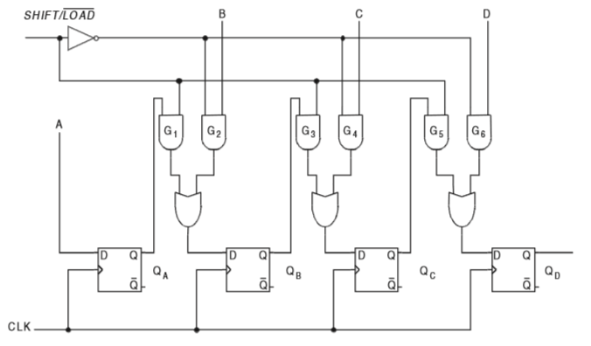
PARALLEL-IN–SERIAL-OUT REGISTER

Slide 25
A, B, C, and D are the four parallel data input lines and SHIFT / LOAD (SH / LD) is a control input that allows the four bits of data at A, B, C, and D inputs to enter into the register in parallel or shift the data in serial.
When SHIFT / LOAD is HIGH, AND gates G1, G3, and G5 are enabled, allowing the data bits to shift right from one stage to the next.
When SHIFT / LOAD is LOW, AND gates G2, G4, and G6 are enabled, allowing the data bits at the parallel inputs.
When a clock pulse is applied, the ﬂ ip-ﬂ ops with D = 1 will be set and the ﬂ ip-ﬂ ops with D = 0 will be reset, thereby storing all the four bits simultaneously.
The OR gates allow either the normal shifting operation or the parallel data-entry operation, depending on which of the AND gates are enabled by the level on the SHIFT / LOAD input.

Slide 26
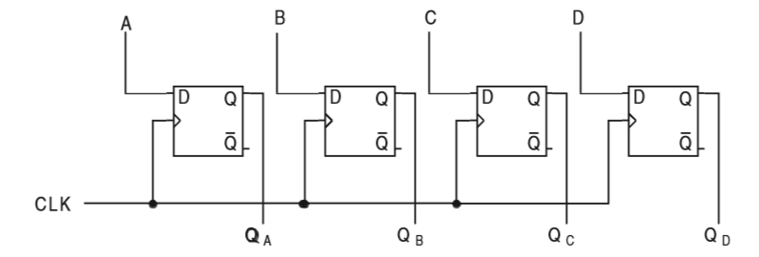
PARALLEL-IN–PARALLEL-OUT REGISTER

Slide 27
Here the parallel inputs to be applied at A, B, C, and D inputs are directly connected to the D inputs of the respective ﬂip-ﬂops.
On applying the clock transitions, these inputs are entered into the register and are immediately available at the outputs Q1, Q2, Q3, and Q4

Slide 28
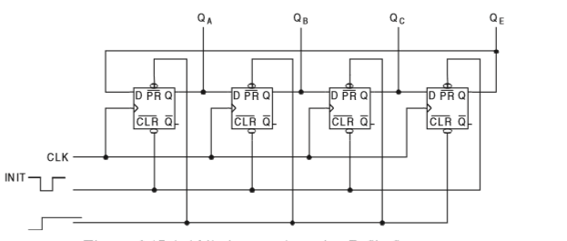
SHIFT REGISTER COUNTERS
Ring Counter (Ref Class Notes)
The PRESET input of the last ﬂ ip-ﬂ op and the CLEAR inputs of the other three ﬂ ip-ﬂ ops are connected together.

Slide 29
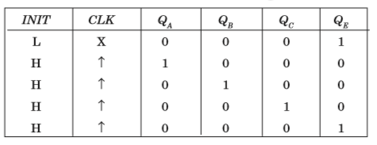
Truth Table of Ring Counter

Slide 30
Johnson Counter/Switch Tail Ring Counter
Refer Class Notes

Slide 31
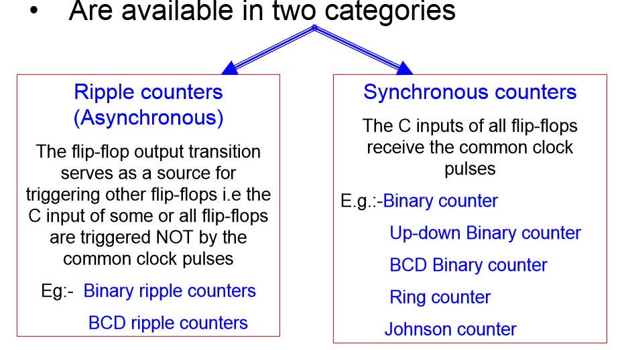
COUNTERS

Slide 32
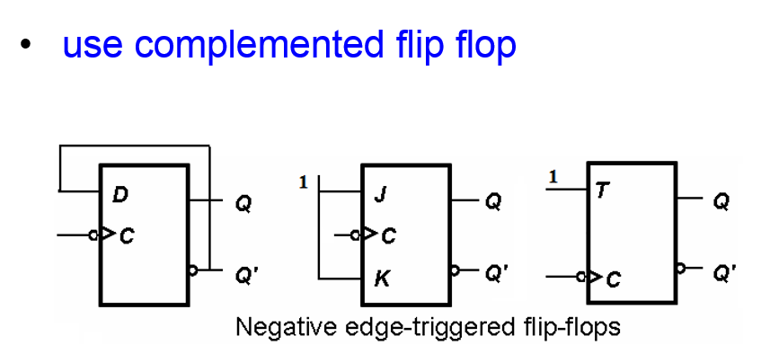
Ripple counters

Slide 33
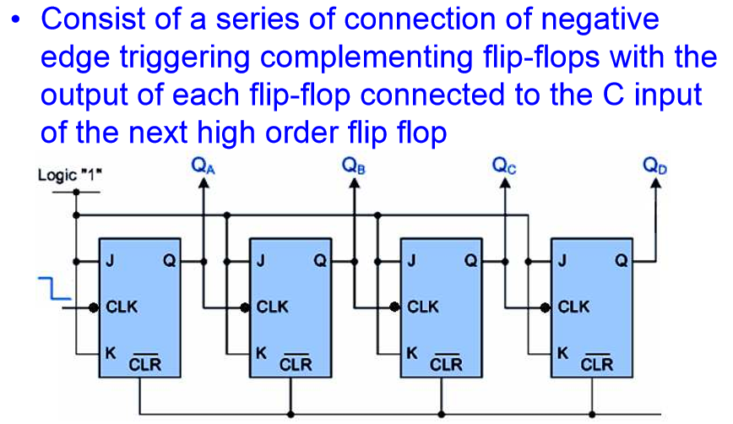
Binary Ripple up counter

Slide 34
The flip flop holding the LSB receives the input pulses.
The count starts with binary 0 and increments by one with each count pulse input
After the count 15 the counter goes back to binary 0 to repeat the count

Slide 35
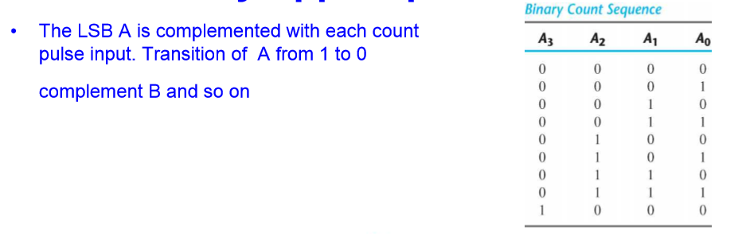

Slide 36
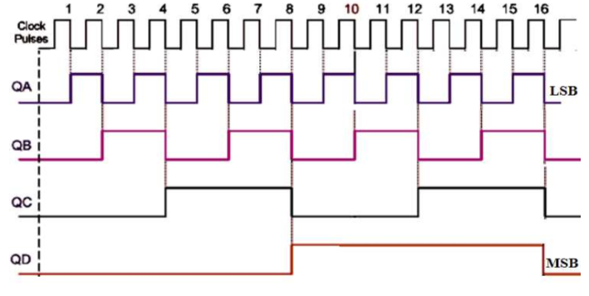

Slide 37
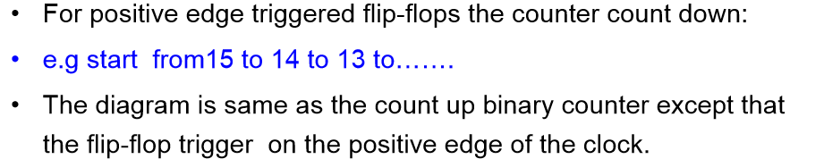
Binary Ripple down counter

Slide 38
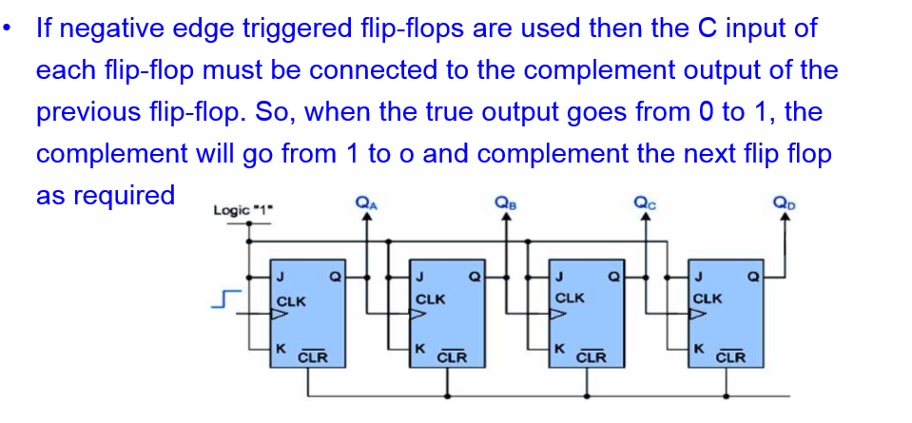

Slide 39
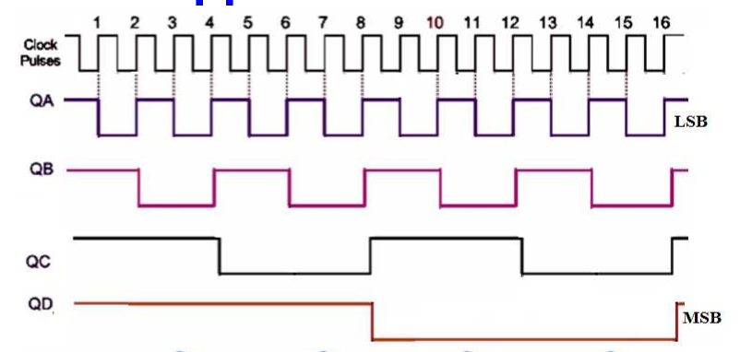

Slide 40
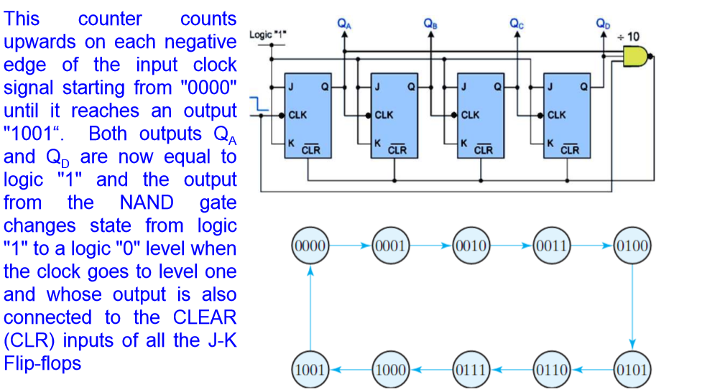
BCD Ripple Counter, Decade counter

Slide 41
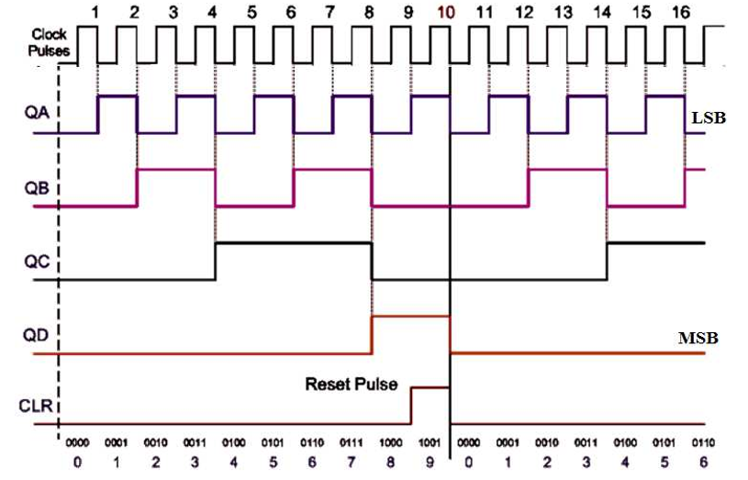
Decade Counter Timing Diagram

Slide 42
Synchronous counters
Binary Counters
Up-Down Binary Counter
BCD Counter
Binary counter with Parallel Load
Ring and Johnson counters
-they are used to generate time signals necessary
for digital operations
FFs in the counter are clocked at the same time by a common clock pulse.
The design procedure is the same as that of sequential circuit

Slide 43
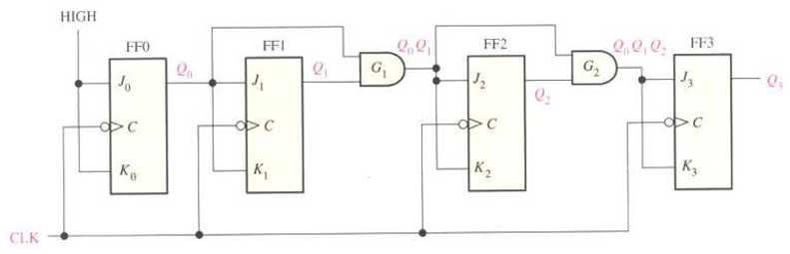
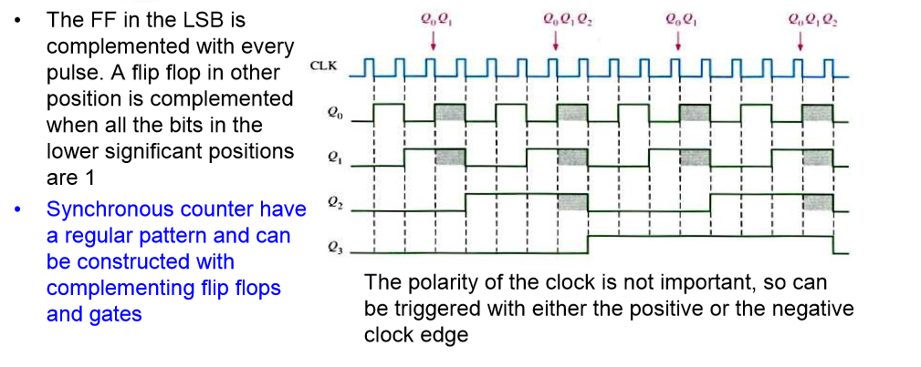
Binary Synchronous Counter

Slide 44
Synchronous counter Design
Ref Class Notes

Slide 45
Flip-Flop Conversions
Ref Class Notes

Slide 46
Memory and its types
Ref Class Notes

